Slide 1

Secure Proximity solutions (sps), LLC

Slide 2

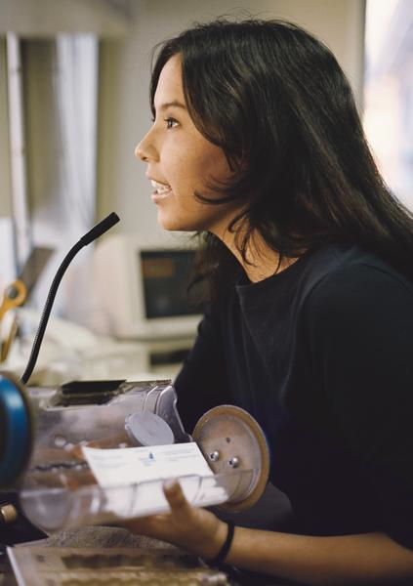
Problem
Banking Industry:
  High security
    Required Log in/out
    Sensitive Data on Workstations
  High need for audit trails
    Who entered transactions
    How many hours worked
  Time efficiency
    Speed to log in/out on machines

Slide 3
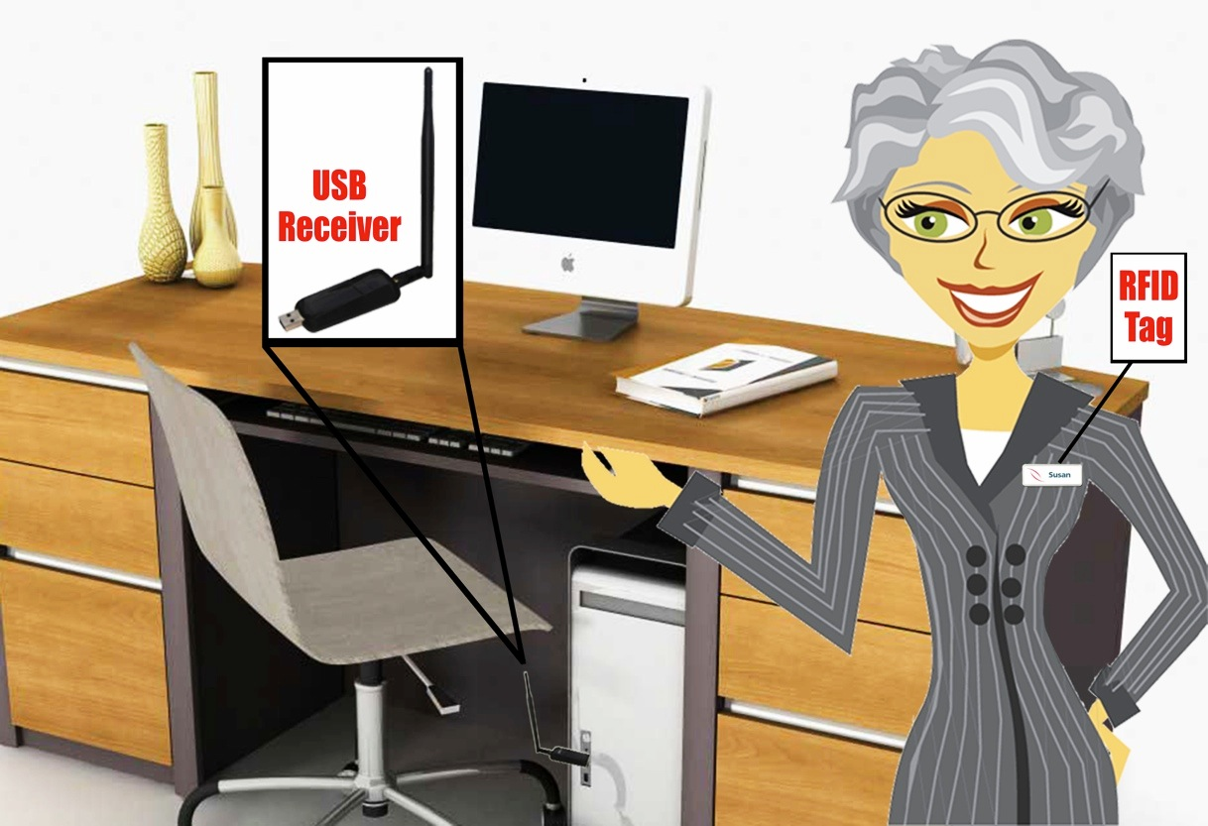
Solution!
Product Includes:
  USB sensor
  RFID name tag
  Software
Value Provided:
  Security
  Time efficient
  Audit trail

Slide 4
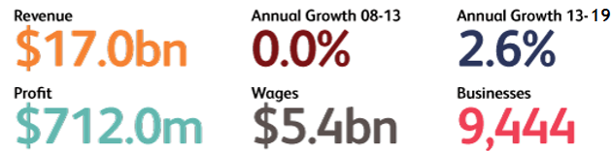
Industry Analysis
NAICS Code: 56162 – Security Industry
High profit to revenue
New growth

Slide 5
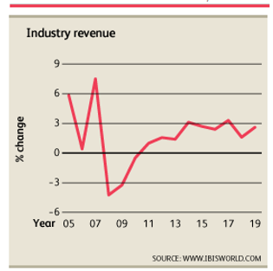
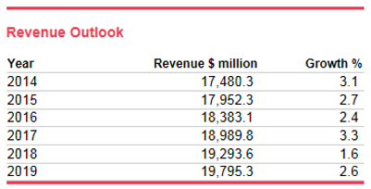
Cont…
Recovering from 2008 financial crash
Promising future revenue outlook

Slide 6
Target Market
First Year:
  1,500 banks and credit unions in Kansas
  50% market share + 10 units/branch
Second Year:
  80% Kansas market share
  Colorado, Oklahoma, Missouri, Nebraska
Third Year:
  Worldwide

Slide 7
Competition
Strengths
Weaknesses
ProxLock
RFIdeas
Compatible with existing card systems
Wide range of accessories
Complicated
Expensive
Affordable
Simple Design
User-Friendly Software
XyLoc
Simple
Affordable
By Quote Only
Bulky
Batteries Required
Direct Sales
Compact Design
No Batteries Requied

Slide 8
Marketing Plan
Marketing Message - “Low cost effective solutions that saves you time and money!”
Direct Sales
  Trade shows
  Cold calls
  Finance industry journals
  Personal sales
  Website/web-store
  Direct mail

Slide 9
Management Team
Collin Shores – CoFounder/CFO. BS in Business Administration Majors: Management Information Systems, Entrepreneurship with an Emphasis in Real Estate
Ciara Thyfault – CoFounder/Director in Marketing. BS in Marketing with a Minor in Entrepreneurship
Research and Development Team:
  Adjete Mensah – BS in Computer Science Engineering
  Quisheng Ho –BS in Computer Software Engineering
Tim Collins – Advisor – IT Security Administrator at FlintHills Resources

Slide 10
Financial Highlights
Pre-Money Valuation:
  $500,000
  Second year sales multiplied by 2.5
  Seeking $100,000 investment for 20% stake in the company
Source & User of Funds
  The initial 4 members will raise $50,000 to add to the $100,000 investment
  Finish R&D
  Produce initial inventory
  Begin marketing

Slide 11
Financial Highlights Cont.
Sales are predicted to grow 30% each year
We are selling our units for $30 each
Cost of Goods Sold will be $10 each
First year sales will be 5,000 units
Break Even point is $25,500 or 850 units

Slide 12
Financial Highlights Cont.
Sales & Income

Slide 13
Exit Plan
Goals:
  Gain additional investors
  Expand into other markets quickly
  Achieve high market share worldwide
  Go public or Sell the company

Slide 14
Summary
Secure Proximity Solution’s ProxLock is the key to workstation security and efficiency
The market for cyber security solutions is growing
Banks have a high need for efficiency, security, and audit tails
Proxlock is an easy, affordable, and reliable option to meet this need
A $100,000 investment will allow us to bring this solution to customers who need it

Slide 15
Questions?

